Slide 1
Case Study – Budweiser Brewery Insights
The Bitter Truth Insights
Indy Dhillon, Jamie Vo, & Nick Blair
Notes:
<Nick>

Slide 2
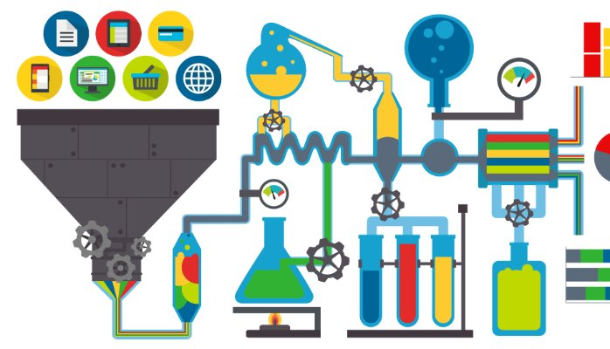
Outline for today
Overview of data
http://gcmouli.com/blog/2017/01/inference-and-insights/
Notes:
<Nick>

Slide 3
Outline for today
Overview of data
Summary of ABV & IBU data
http://gcmouli.com/blog/2017/01/inference-and-insights/
Notes:
<Nick>

Slide 4
Outline for today
Overview of data
Summary of ABV & IBU data
Initial insights
http://gcmouli.com/blog/2017/01/inference-and-insights/
Notes:
<Nick>

Slide 5
Overview of data: Set layout
Two separate data sets: breweries and beers
Merged based using brewery ID
Total number of breweries: 558
Per state: 1 (min) to 47 (max)
Notes:
<Jamie>
Combined data set contains the following variables:
Brewery ID
Brewery name
Brewery location (city and state)
Beer name
Beer name and ID
(each row is a separate beer; this means the same locations, brewery names, and brewery IDs appear frequently)
ABV value for each beer
IBU value for each beer
Style of each beer
Volume in ounces that the beer is served by
Colorado has 47 total breweries including two instances of Oskar Blues brewery.

Slide 6
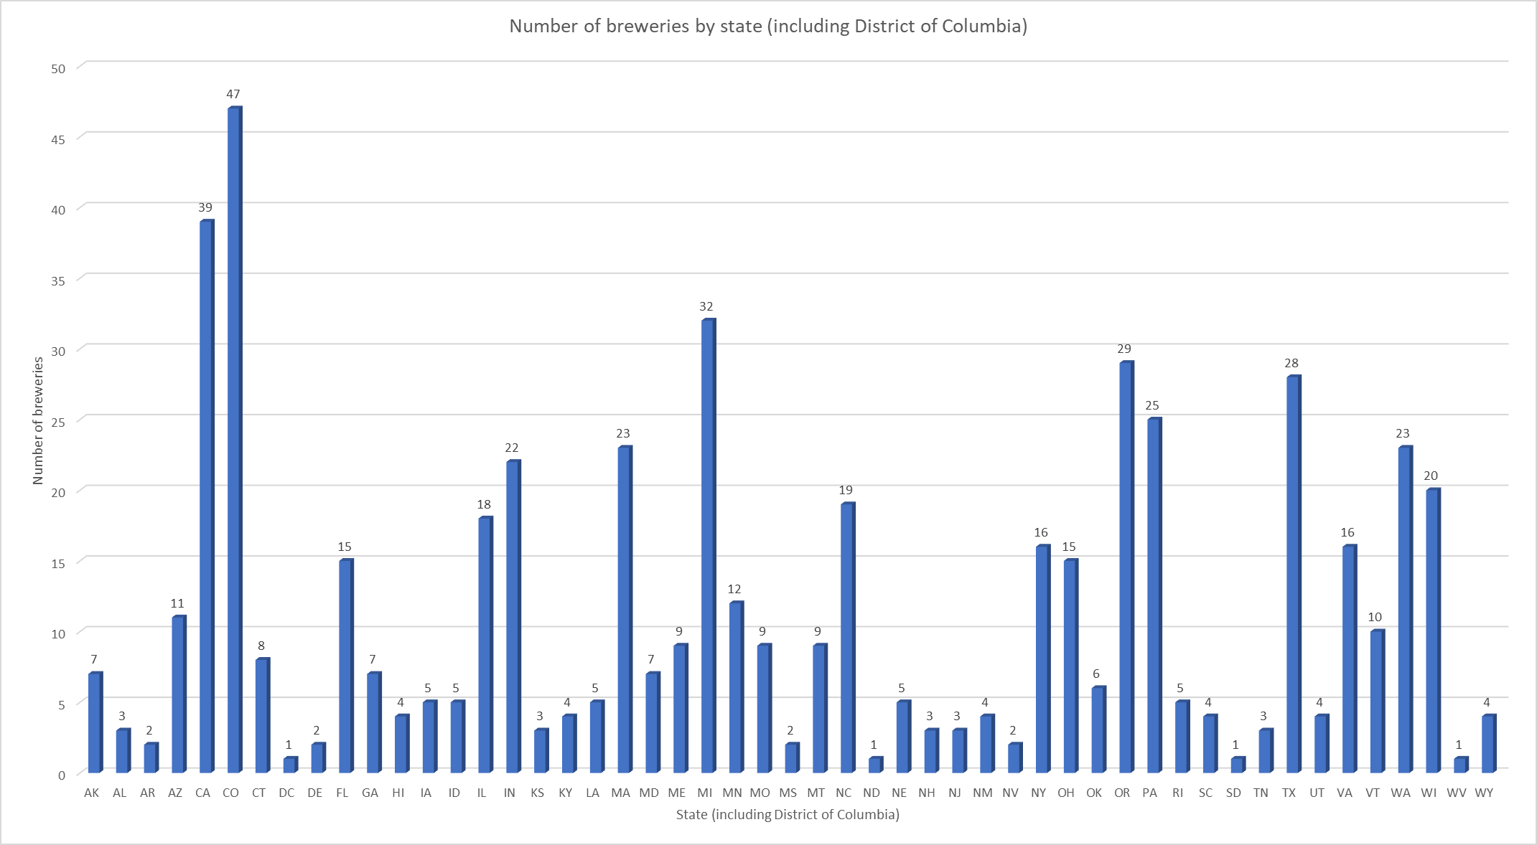
Notes:
<Jamie>
Colorado has 47 total breweries including two instances of Oskar Blue

Slide 7
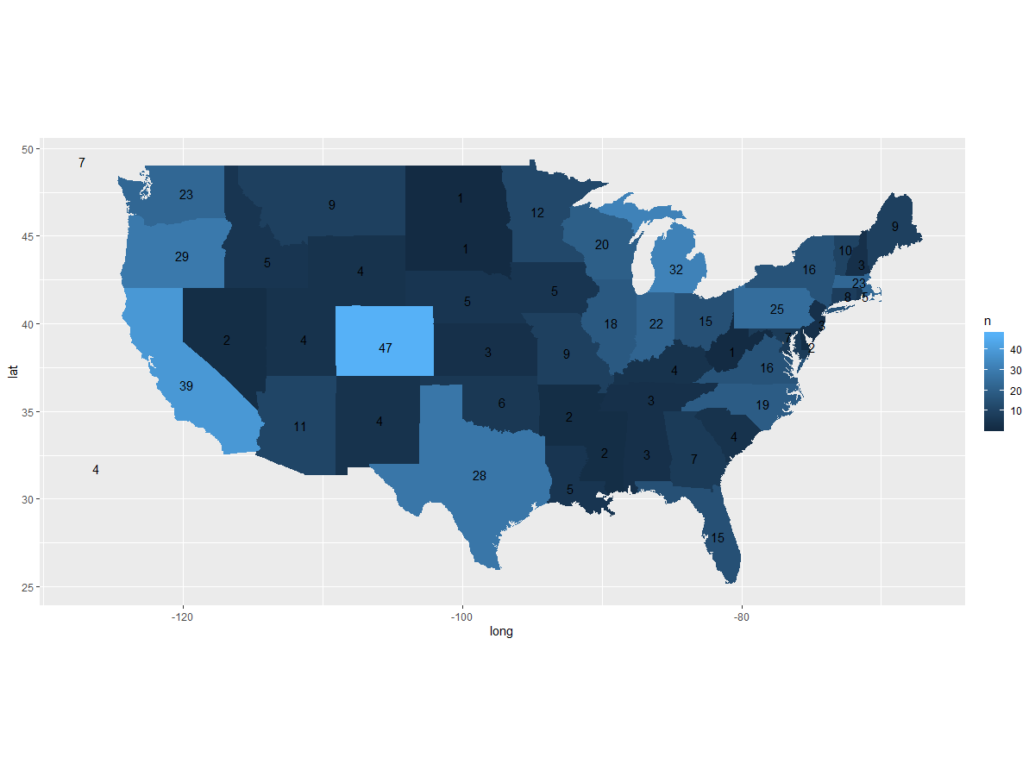
Heatmap of number of breweries per state (including DC)
Latitude
Longitude
Notes:
<Jamie>
Colorado has 47 total breweries including two instances of Oskar Blues brewery.

Slide 8
Data overview: missing values
Missing values in ABV & IBU
Notes:
<Nick>

Slide 9
Data overview: missing values
Missing values in ABV & IBU
Possibly due to state laws, complexity of testing
Notes:
<Nick>

Slide 10
Data overview: missing values
Missing values in ABV & IBU
Possibly due to state laws, complexity of testing
Two methods for handling missing values:
Eliminate missing data lines
Replace missing data values with average of relevant values
Notes:
<Nick>

Slide 11
Comparison of correction methods
Using missing data method 1:
Minimum: 2.7%
1st Quartile: 5.0%
Median: 5.7%
3rd Quartile: 6.8%
Maximum: 12.5%
Mean 5.991%
Standard Deviation: 1.358
Using missing data method 2:
Minimum: 0.100%
1st Quartile : 5.0%
Median: 5.7%
3rd Quartile : 6.7%
Max: 12.8%
Mean: 5.977%
Standard Deviation : 1.337
Notes:
<Nick>

Slide 12
Comparison of correction methods
Using missing data method 1:
Minimum: 2.7%
1st Quartile: 5.0%
Median: 5.7%
3rd Quartile: 6.8%
Maximum: 12.5%
Mean 5.991%
Standard Deviation: 1.358
Using missing data method 2:
Minimum: 0.100%
1st Quartile : 5.0%
Median: 5.7%
3rd Quartile : 6.7%
Max: 12.8%
Mean: 5.977%
Standard Deviation : 1.337
Notes:
<Nick>

Slide 13
Summary of ABV & IBU
Lowest median ABV: Arizona & Texas (4.00%)
Highest median ABV: Maine & Colorado (6.7%, 6.5% respectively)
Average median ABV: 5.6% ABV
Notes:
<Nick>
Why we chose median over average
Values of lowest and highest ABV & IBU

Slide 14
Summary of ABV & IBU
Lowest median ABV: Arizona & Texas (4.00%)
Highest median ABV: Maine & Colorado (6.7%, 6.5% respectively)
Average median ABV: 5.6% ABV
Lowest median IBU: Wisconsin (19 IBU)
Highest median IBU: Maine (61 IBU)
Average median IBU: 36.98 IBU
Notes:
<Nick>
Why we chose median over average
Values of lowest and highest ABV & IBU

Slide 15
Summary of ABV & IBU
Lowest median ABV: Arizona & Texas (4.00%)
Highest median ABV: Maine & Colorado (6.7%, 6.5% respectively)
Average median ABV: 5.6% ABV
Lowest median IBU: Wisconsin (19 IBU)
Highest median IBU: Maine (61 IBU)
Average median IBU: 36.98 IBU
Maine highest in ABV and IBU
Notes:
<Nick>
Why we chose median over average
Values of lowest and highest ABV & IBU

Slide 16
Initial insight: ABV & IBU
Moderate to moderately-strong correlation.
Using method 1: R is 0.671 indicating a moderately strong connection.
Using method 2: R is 0.520 indicating a moderate connection.
Notes:
<Indy>
Using both methods for accounting for missing data, there appears to be a moderate to moderately-strong correlation between increasing bitterness (IBU) and alcohol content (ABV).
Using method 1, the correlation between the two variables using Pearson’s R is 0.671 indicating a moderately strong connection.
Using method 2, the correlation between the two variables using Pearson’s R is 0.520 indicating a moderate connection.

Slide 17
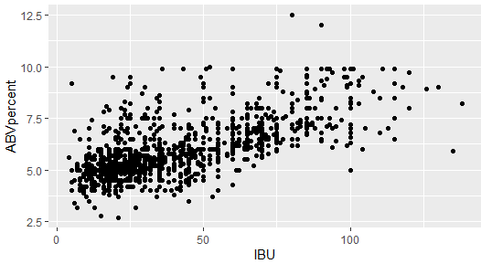
Relationship between ABV & IBU
Notes:
<Indy>

Slide 18
ABV & IBU By Style of beer
Top 12 styles represent 65% of the beers in the data
Style | Correlation
American IPA | 0.49
American Pale Ale (APA) | 0.58
American Amber / Red Ale | 0.60
American Double IPA | 0.15
American Blonde Ale | 0.59
American Pale Wheat Ale | 0.02
American Porter | 0.14
American Brown Ale | 0.42
Fruit / Vegetable Beer | 0.31
Hefeweizen | 0.34
Kölsch | 0.11
Witbier | 0.24
Notes:
<Indy>

Slide 19
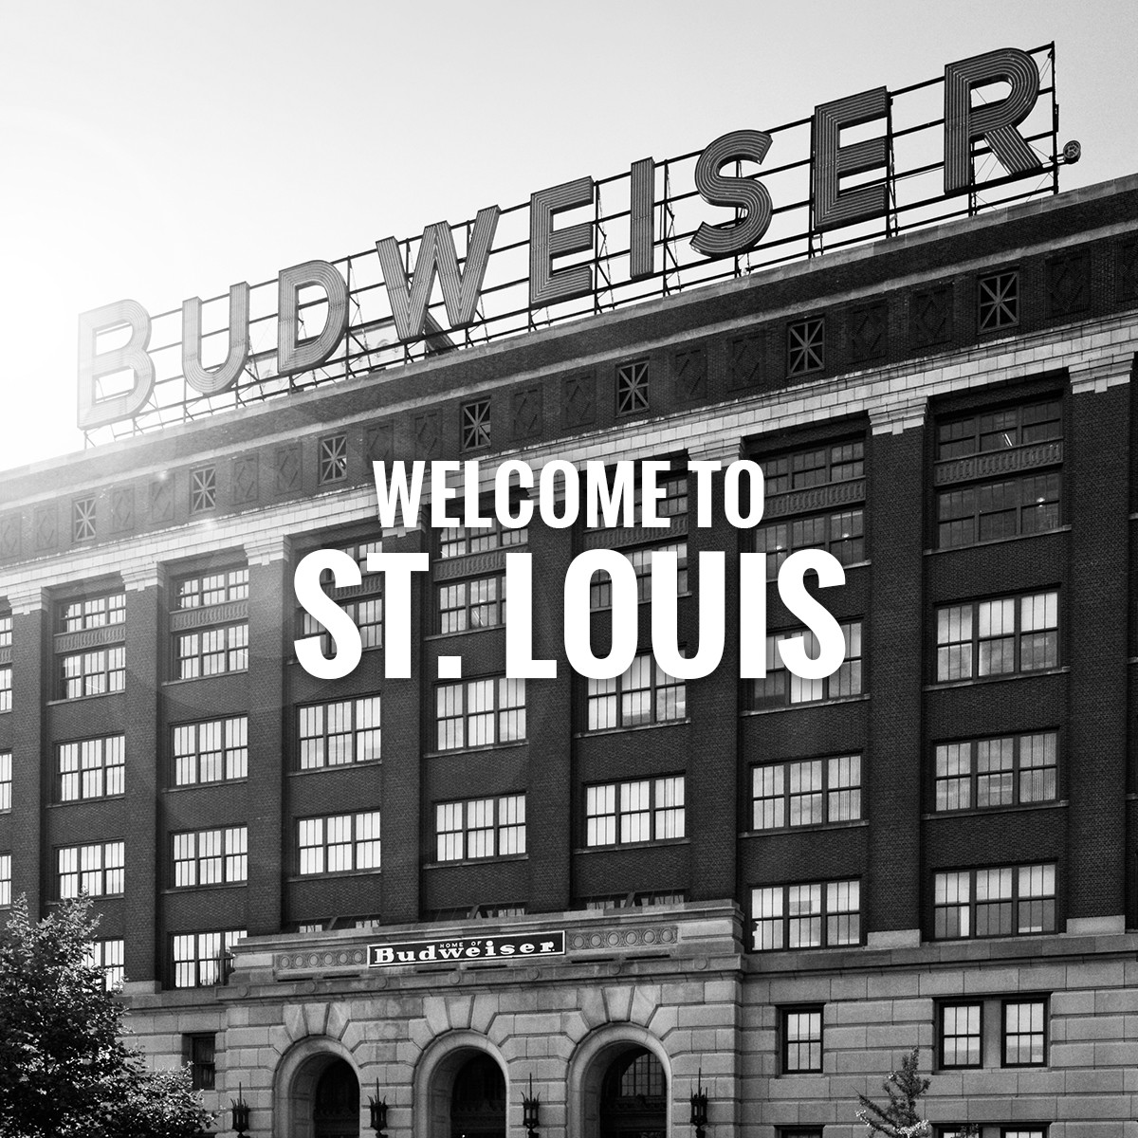
Thank you for your time and considertation!
Further questions or concerns? Please contact:
Indy Dhillon (idhillon@smu.edu)
Jamie Vo (jamiev@smu.edu)
Nick Blair (nicholasb@smu.edu)
Photo credit: https://www.budweisertours.com/locations/st-louis-missouri.html
Notes:
<Indy>

Slide 20
<Problem?>
<Solution code/explanation>

Slide 21
<Problem?>
<Written conclusion>

